Slide 1

WebScraping Project
on
Books to Scrape

Slide 2
About me:
Name: Chiluka Suvarna
Education: Bachelor of Technology (B.Tech)
Branch: Computer Science & Engineering
Project Context:
The Books to Scrape web scraping Project is focused on analyzing data collected from the Books to Scrape website, a popular demo site for practicing web scraping techniques.
Objective: Perform Exploratory Data Analysis (EDA) on books dataset

Slide 3
Introduction
Motivation
The Books to Scrape dataset was chosen because it is publicly available source that allows web scraping and data analysis.
It contains a wide variety of books across 50 categories, making it an excellent resource for learning and applying data preprocessing, exploratory data analysis (EDA) with insights.
Importance of Analyzing Book Datasets
“Analyzing book datasets enables us to uncover trends in pricing, ratings, and categories, helping identify valuable genres, understand customer preferences, and derive insights that can guide pricing strategies, marketing, and recommendation systems.”

Slide 4
Web Scraping & Data Collection:
Source: Books to Scrape website [http://books.toscrape.com]
Tools: requests, BeautifulSoup, python, pandas
Total data collected: 1000 books
Scraped attributes: Title, Price, Rating, Category, Description, Link, UPC, Availability
Dataset Overview:
8 columns → Title, Price, Rating, Availability, Category, Description, Link, UPC
1000 rows

Slide 5
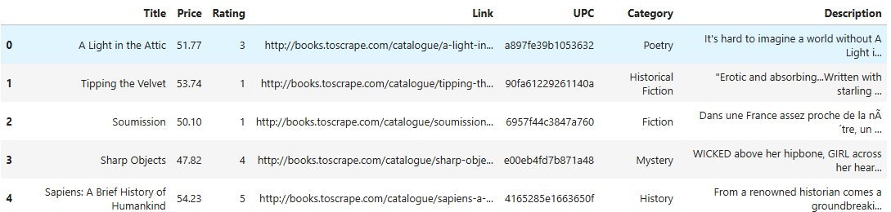
DataSet Overview

Slide 6
Column Descriptions
Title – Name of the book
Price – Book price in GBP (£)
Rating – Customer rating (1–5 stars)
Category – Genre (50 unique categories)
Description – Book summary
Link, UPC – Identifiers
Availability – Availabitity of book(ex: In stock)

Slide 7
Data Preprocessing
Removed 'Â£' symbol from Price column and converted Price → numeric type
Converted Rating words → numbers (1–5)
Filled missing Description with 'No description'
Dropped Availability column, has only one value In stock
Checked duplicates & outliers - None found

Slide 8
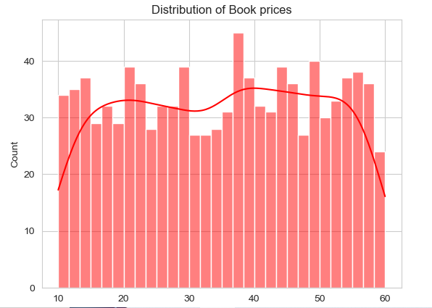
Univariate Analysis
Price:
Average price ≈ £35, min = £10, max = £60.
Fairly even distribution, with some books priced higher but no extreme outliers.

Slide 9
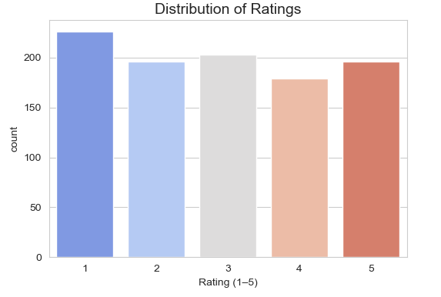
Ratings: Ratings range from 1–5, with a bias towards 1-star and 3-star books.

Slide 10
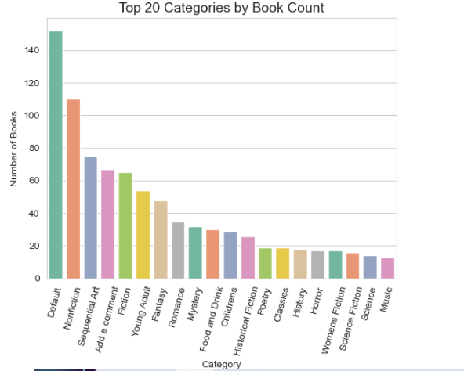
Categories: 50 unique categories. Top categories: Default, Fiction, Nonfiction, Children’s, History.

Slide 11
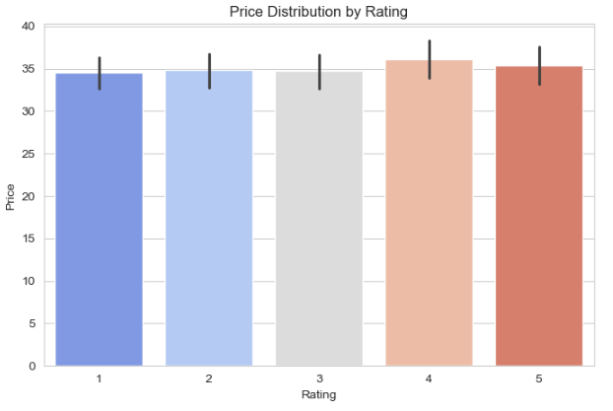
Bivariate Analysis
Price vs Rating:
No strong correlation (cheap and expensive books exist across all ratings).
However, books with 4-star ratings tend to have slightly higher median prices.

Slide 12
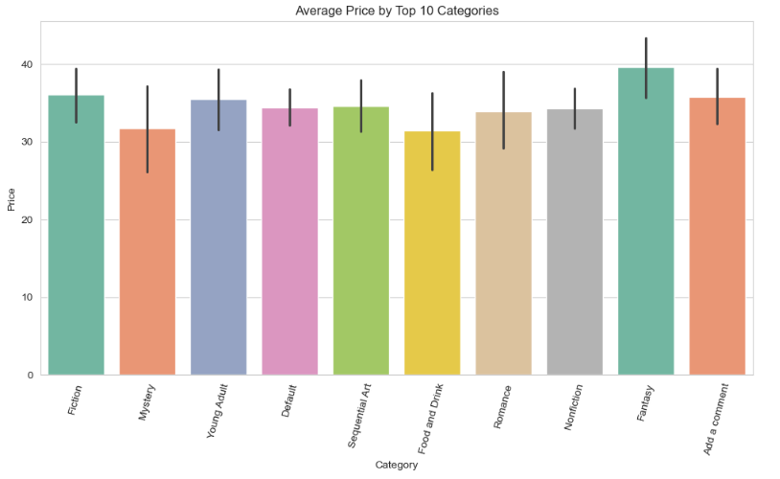
Category vs Price: Categories like Academic, History, and Poetry have higher average prices. Categories like Children’s, Young Adult have lower average prices.

Slide 13
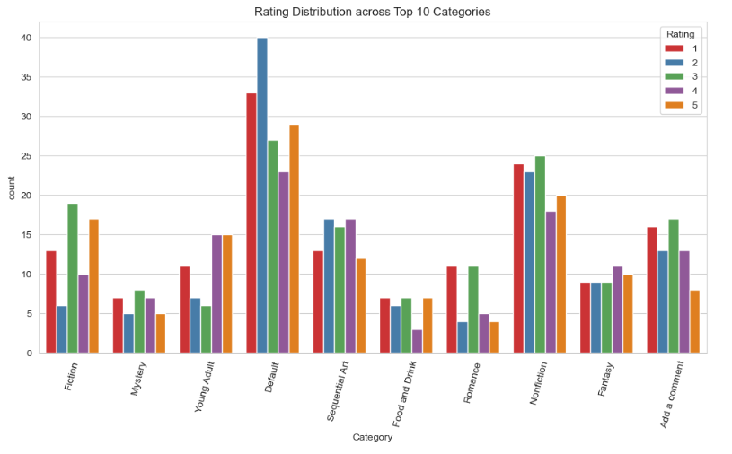
Rating vs Category: Some categories are dominated by lower ratings (e.g., Fiction has many 1-stars). Niche categories (e.g., Science, Philosophy) skew towards higher ratings.

Slide 14
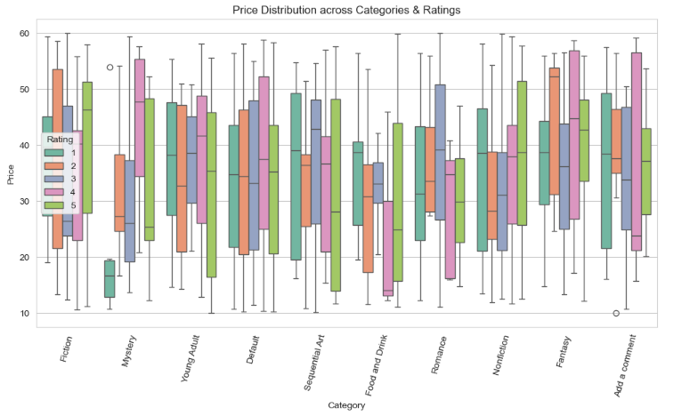
Multivariate Analysis
Category × Rating × Price:
Expensive categories (e.g., Academic) also have higher-rated books on average.

Slide 15
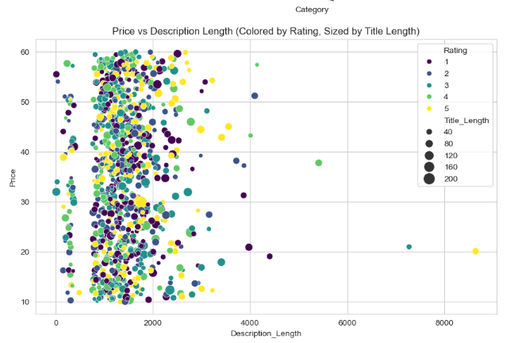
Text Lengths vs Price: Books with longer descriptions are often slightly more expensive, possibly reflecting more “serious” books.

Slide 16
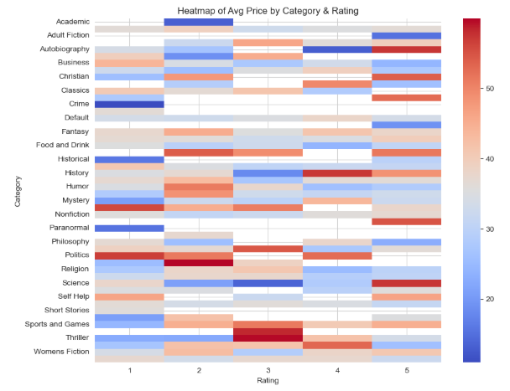
Heatmap Insight: Categories with fewer books tend to cluster around mid-to-high ratings, suggesting specialized categories may deliver better-quality books.

Slide 17
Actionable Insights
Pricing Strategy: Books priced between £20–£40 sell faster → Focus promotions on this price range.
Genre Popularity: Travel and Fiction categories have the highest ratings → Expand catalog in these categories.
Customer Engagement: Higher-rated books receive more reviews → Encourage reviews to boost visibility.
Stock Management: Low-rated books have more unsold inventory → Reduce stocking of such categories.

Slide 18
Conclusion
Effective web scraping and preprocessing enabled clean and structured data for analysis.
Clear trends emerged in ratings, categories, and availability that highlight customer preferences.
Demonstrated the power of data-driven analysis in guiding decisions for online book marketplaces.

Slide 19

THANK YOU

